Slide 1
South Park: Document classification Problem
Samuel Hinh
Python for Data Science, CSCI E-29
Harvard University

Slide 2

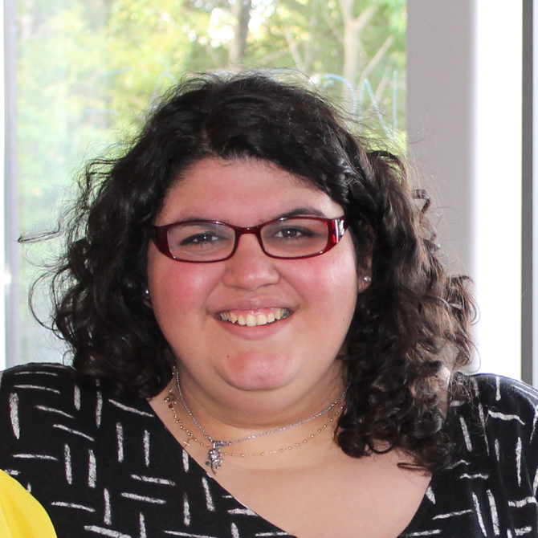
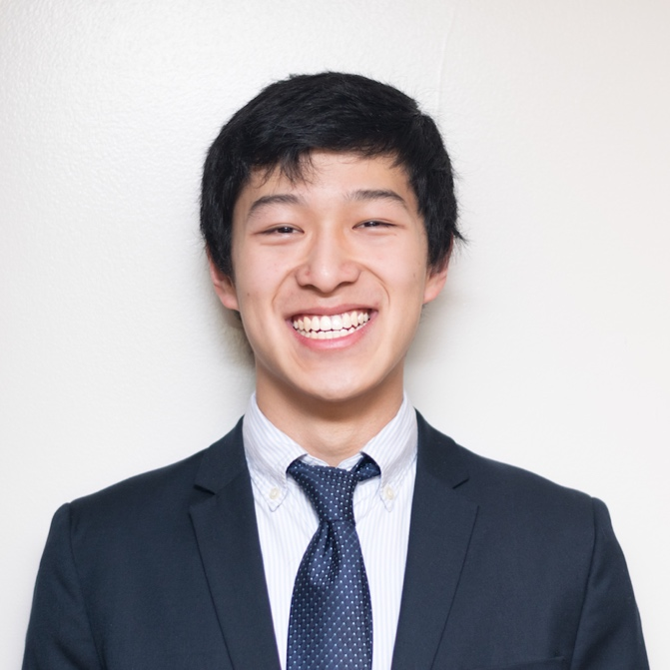
CSCI E-29 2018 Staff
Nenad Svrzikapa
Instructor
Lena Hajjar
Teaching Fellow
Philip Lodine
Teaching Fellow
Kaleigh Douglas
Teaching Fellow
Alan Xie
Teaching Fellow
Joe Palin
Teaching Fellow

Slide 3
Required Libraries and files
pandas
conda install -c anaconda pandas=0.19.2
numpy
pip install numpy
profanity
pip install profanity
sklearn
pip install sklearn
Dataset Location
https://www.kaggle.com/tovarischsukhov/southparklines/data
Code Location
https://github.com/hinhs/harvard_CSCIE29_final_project.git

Slide 4
Abstract
Max = 10
This project will give a brief overview of the dialogue in the show South Park. First, we did brief analysis on the profanity in the show. Then, we performed a document classification problem by predicting which lines of dialogue belonged to which character in the show.
We also experimented which model gives the best results and try to Tweek methods to increase the model accuracy.

Slide 5
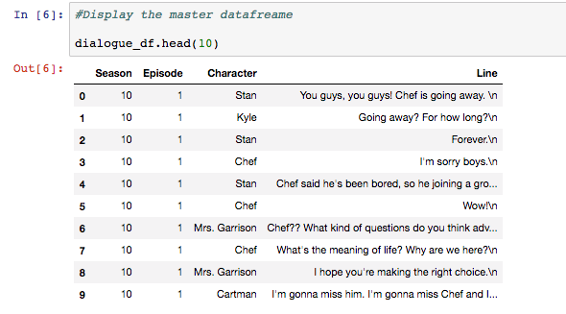
Data description
Get familiar with the data

Slide 6
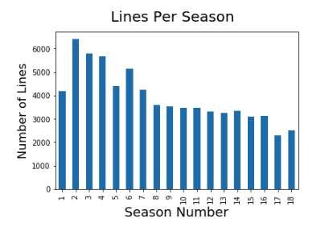
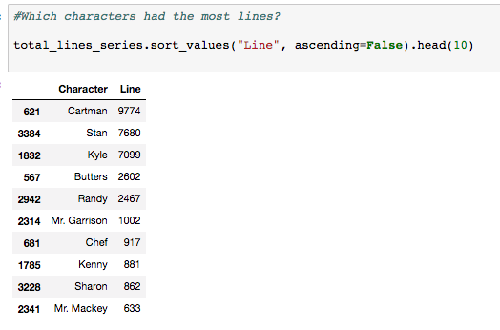
Data Description

Slide 7
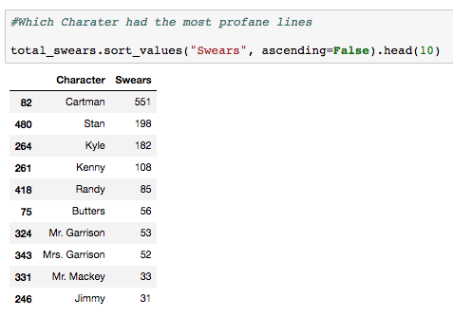
Important stats about profanity
What are some insightful numbers from the dataset?

Slide 8
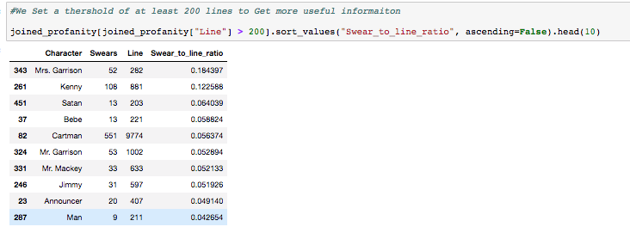
Important stats about profanity
What are some insightful numbers from the dataset?

Slide 9
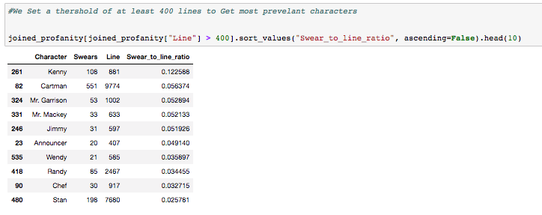
Important stats about profanity
What are some insightful numbers from the dataset?

Slide 10
Line Classification
Overview
Predict who said what line
Almost like a document classification problem

Slide 11
Line Classification
Details
Heuristics
Used only a few characters: Kenny, Kyle, Butters, Stan, Cartman, and Randy
TFIDF
Models
Logistic Regression
Random Forest
Linear SVC
Gaussian Naïve Bayes
Multinomial Naïve Bayes

Slide 12
Line Classification
Results
Models Accuracy
Logistic Regression: 44.68
Random Forest: 32.24%
Linear SVC: 45.03%
Gaussian Naïve Bayes: 22.75%
Multinomial Naïve Bayes: 41.37

Slide 13
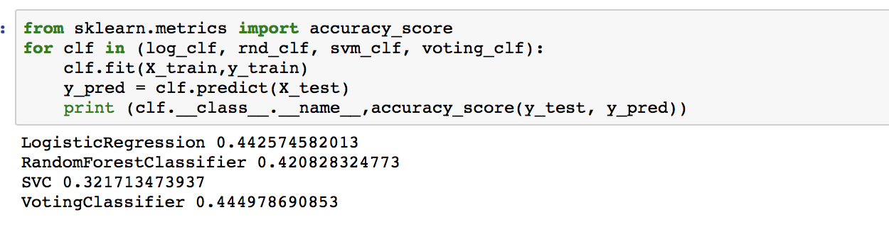
Line Classification
Ensemble
Ensemble
Only ran this once cause it took literally 8-9 hours to run
Not much of a difference

Slide 14
How can we improve the Model?
Other Experiments
Stop Words
Logistic Regression: 41.88
Random Forest: 32.98%
Linear SVC: 39.01%
Gaussian Naïve Bayes: 36.65%
Multinomial Naïve Bayes: 39.53%
By Season? There is some character development in the show. What if we don’t pool all the data into one, would that help?

Slide 15
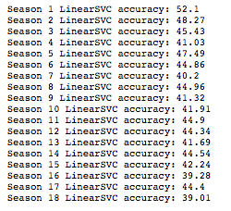
How can we improve the Model?
Not much change

Slide 16
How can we improve the Model?
Suggestions for Further experiments
Create additional features
Utilize swear to line ratio
Word2vec word similarity
Sentiment analysis score
Experiment more with Ensemble; try other combination of models

Slide 17
REFERENCES
https://www.kaggle.com/tovarischsukhov/southparklines/data
http://scikit-learn.org/stable/modules/generated/sklearn.feature_extraction.text.TfidfVectorizer.html

